Slide 1
Environmental Data Extraction
Breeding Analytics Core Team
Wednesday, 26 July 2023

Slide 2
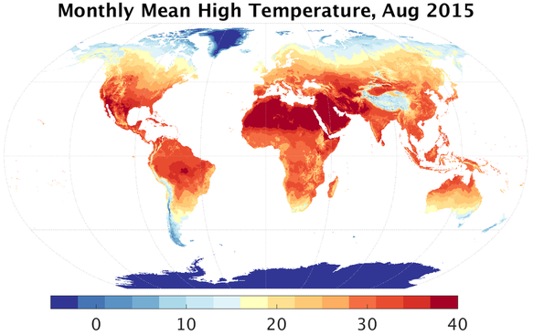
TerraClimate vs. WorldClim
Abatzoglou, J., Dobrowski, S., Parks, S. et al. TerraClimate, a high-resolution global dataset of monthly climate and climatic water balance from 1958–2015. Sci Data 5, 170191 (2018). https://doi.org/10.1038/sdata.2017.191
1958-2022 vs. 1970-2000 monthly temporal resolution, climate change trends!
14 vs. 7 climate variables tmin, tmax, tavg, ppt, srad (solar radiation), wind (speed), vap (vapor pressure), evapotranspiration, soil moisture, PDSI (Palmer Drought Severity Index), etc.
~4 km vs. ~1 km spatial resolution
19 bioclimatic variables (QBMS vs. pre-calculated) derived variables represent annual, seasonal, and extreme aggregate for temperature and precipitation (warmest, coldest, wettest, and driest quarter)

Slide 3
Online vs. Offline Climate Data Retrieval
remotes::install_github("icarda-git/QBMS")
library(QBMS)
ini_terraclimate(from = '2018-09-01', to = '2019-06-30',
clim_vars = c('ppt', 'tmin', 'tmax'),
data_path = './data/', timeout = 300)
data <- get_terraclimate(lat = 33.616, lon = -6.716,
from = '2018-09-01', to = '2019-06-30',
clim_vars = c('ppt', 'tmin', 'tmax'),
offline = TRUE)
data$climate[[1]] # df for monthly climate variables (1st location)
data$biovars[[1]] # calculated on-fly

Slide 4
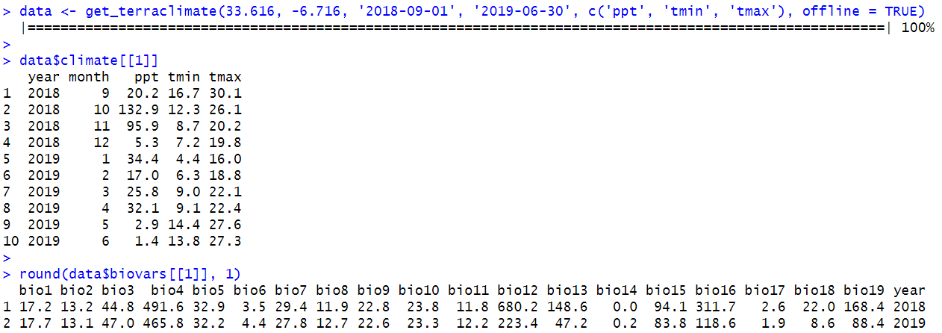
Extract Climate Data Example
aet (Actual Evapotranspiration, monthly total) units = mm
pet (Potential evapotranspiration, monthly total) units = mm
vap (Vapor pressure, average for month) units = kPa
vpd (Vapor Pressure Deficit, average for month) units = kPa
def (Climate Water Deficit, monthly total) units = mm
q (Runoff, monthly total) units = mm
swe (Snow water equivalent - at end of month) units = mm
soil (Soil Moisture, total column - at end of month) units = mm
srad (Downward surface shortwave radiation) units = W/m2
ws (Wind speed, average for month) units = m/s
PDSI (Palmer Drought Severity Index, at end of month) units = unitless
Note: Latitude/longitude coordinates parameters can be a single value, a vector of values, or a data frame variable.

Slide 5
FAO Harmonized World Soil Database
V2 Released in 2023, Data Structure (2-step extraction):
HWSD2 Raster (22MB ZIP → 1.75GB Map, 1 km spatial resolution) (input: latitude/longitude coordinates, output: Soil Mapping Unit ID)
HWSD2 SQL Database (MS-Access vs. SQLite from isric.org, 66 MB) (query HWSD2_LAYERS table using retrieved SMU ID to get soil attributes)
Soil Mosaic: SEQUENCE column, range between 1 and 12 (max), 1 is the dominant soil. SHARE column refers to share% (SEQUENCE = 1)
LAYER column refers to depth layer (D1 to D7). TOPDEP/BOTDEP columns represent top/bottom layer depth in cm. (LAYER = “D1”)

Slide 6
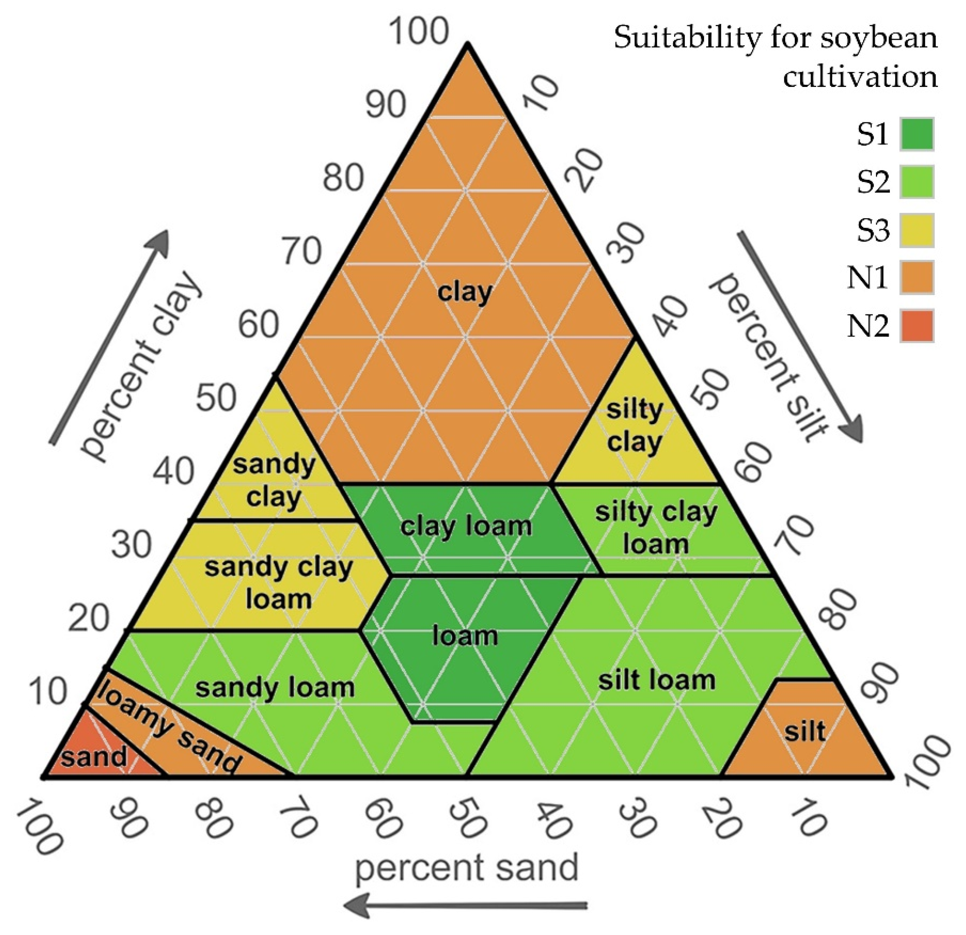
HWSD v2 Layers Metadata
select * from HWSD2_LAYERS_METADATA
ID FIELD UNIT DESCRIPTION DATATYPE DOMAIN
27 SAND % weight Sand Number <NA>
28 SILT % weight Silt Number <NA>
29 CLAY % weight Clay Number <NA>
30 TEXTURE_USDA <NA> Texture class (USDA conventions) Number D_TEXTURE_USDA
…
Other attributes: pH, Organic Carbon Content (% weight),
Total nitrogen content (g/kg), Exchangeable Sodium
Percentage (%), Electric Conductivity (dS/m), etc.
The lookup tables are shown for the coded fields,
e.g., the USDA Texture Class codes (TEXTURE_USDA)
are linked to table D_TEXTURE_USDA.

Slide 7
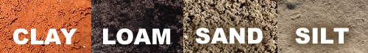
HWSD v2 Helper R Functions on GitHub
source('hwsd2.R')
hwsd2 <- ini_HWSD2(data_path = './data/')
sites <- read.csv('sites.csv')
data <- get_HWSD2(df = sites, con = hwsd2, x = 'Long', y = 'Lat')
smu_id Location Lat Long SEQUENCE SHARE LAYER TOPDEP BOTDEP SAND SILT CLAY TEXTURE_USDA …
3192 Tel-Hadya 36.016 36.943 1 60 D1 0 20 37 33 30 5 …
3559 Terbol 33.808 35.991 1 40 D1 0 20 14 33 53 3 …
1747 Marchouch 33.616 -6.716 1 30 D1 0 20 49 31 20 9 …
dbGetQuery(hwsd2$sqlite, 'select * from D_TEXTURE_USDA where CODE in (3,5,9)')
CODE VALUE
3 Clay (light)
5 Clay loam
9 Loam

Slide 8
Coordinates Data Validation Framework
Format DMS (Degrees Minutes Seconds) vs. DD (Decimal Degrees). (e.g., 33°48’34.32”N, 5°59’20.73”W vs. 33.809534, -5.989091)
Degree Precision vs. Length Scale. (e.g., 0.1 ~10 km City, 0.01 ~1 km Town, 0.001 ~100 m Street, 0.0001 ~10 m Farm)
Issue of mistakenly swapping latitude/longitude data values or sign.
Center of country/district warning!
Utilize Vector Map for Country Boundaries, Neighboring Countries list, Countries Centroids info, etc.

